Slide 1

“Your health, your Village, your world.”
Emerson Albert
Rashad Anderson
David Caro
Rodney Chappell
Trusha Bh

Slide 2
Elevator Pitch ▪ Concept
A health-centered social network made for the purpose of looking out for your friends and letting them know when you may need help.
Considering all the troubles currently going on in the world, and the downward trend of everyone’s mental health, we wanted to create a space that users could be honest about how they’re doing without the distraction of keeping up appearances and other content
User Story
AS developers
WE WANT to create a social network
SO THAT users can post their moods for friends to know about their wellbeing

Slide 3
Elevator Pitch ▪ Process
Technologies used: Apollo, React-Bootstrap, MDBootstrap
Breakdown of tasks/roles
Emerson – Backend
Rashad – Modals folder (components originally meant to be modals)
David – Frontend, some backend
Rodney – Village page
Challenges – Lack of better understanding of backend queries and mutations, initial issues with react styling, time-consuming bugs/errors
Successes – Teamwork and dedication after class,

Slide 4
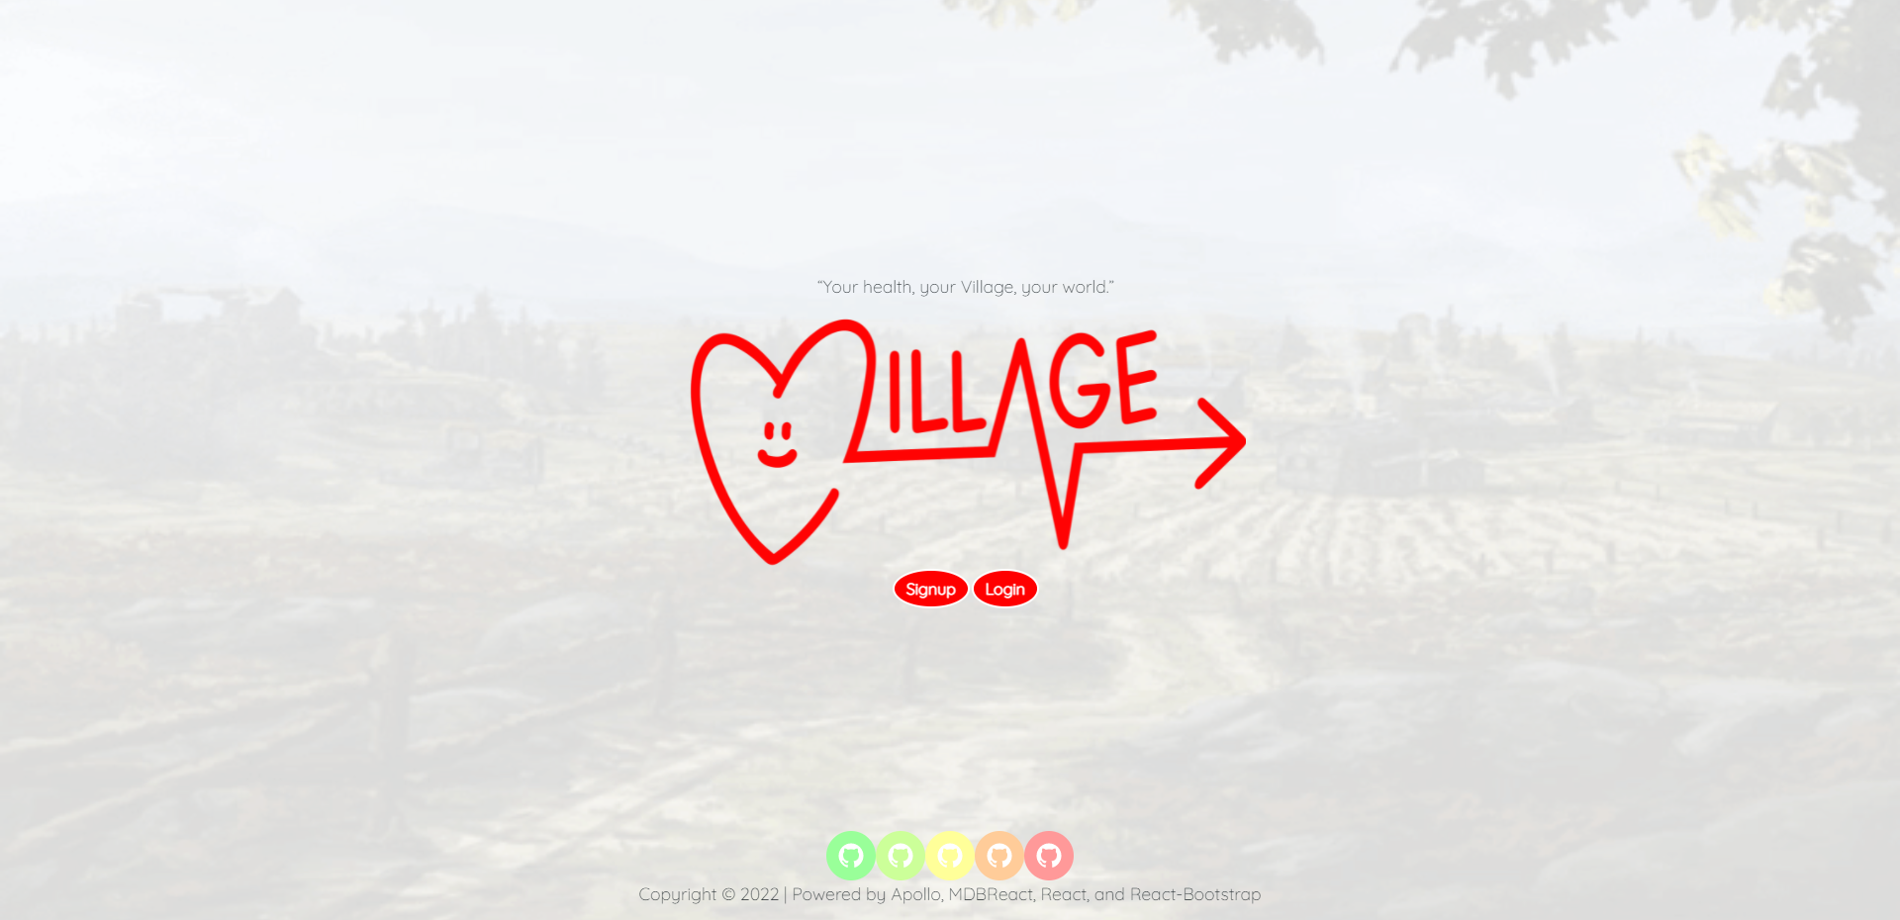
Demo

Slide 5
Directions for Future Development
“Your World” page – add a page that uses WHO API to display world health information that each user may subscribe to
“Find Your Village” friend search – page for each user to search for their friends on the platform and add them directly. In the meantime, we made it so signed-up users automatically have every other user as a friend
Comments/Support – users would be able to comment under posts they see on the Village page to encourage others given their moods

Slide 6
Links
Deployed
https://village-socialapp.herokuapp.com/
Repo
https://github.com/pr1me-e1gh7/Village/

